Slide 1
OpenET and RGGI: Remote Sensing and Ecological Models Meet Next-generation Water and Carbon Policy
Ian Breckheimer
23 January 2022

Slide 2
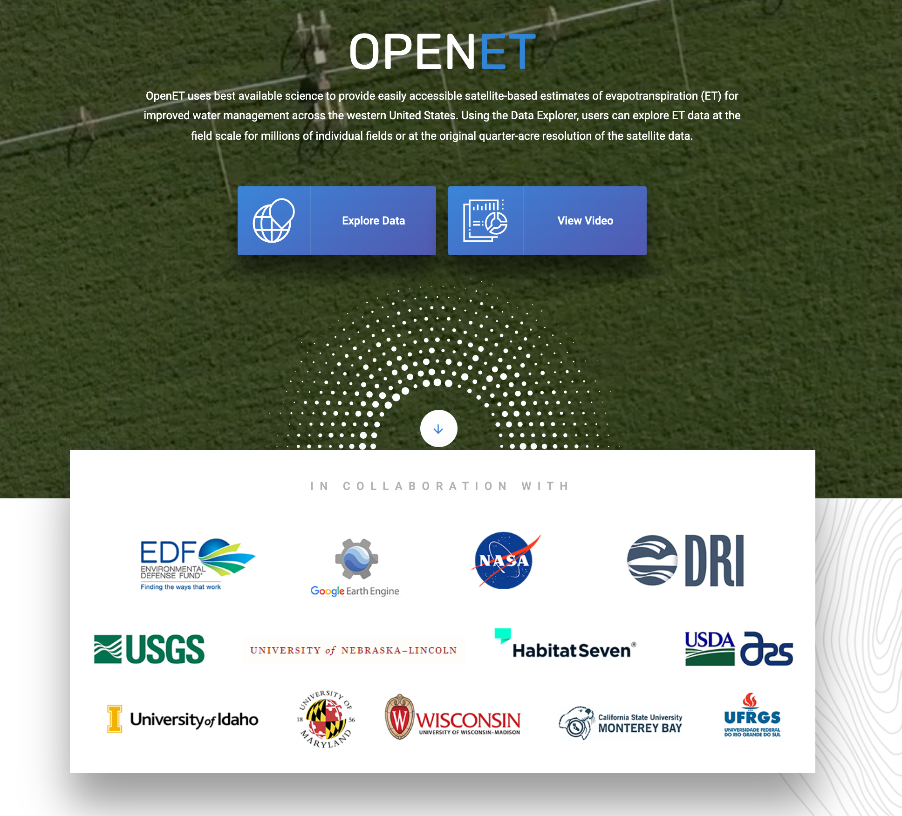
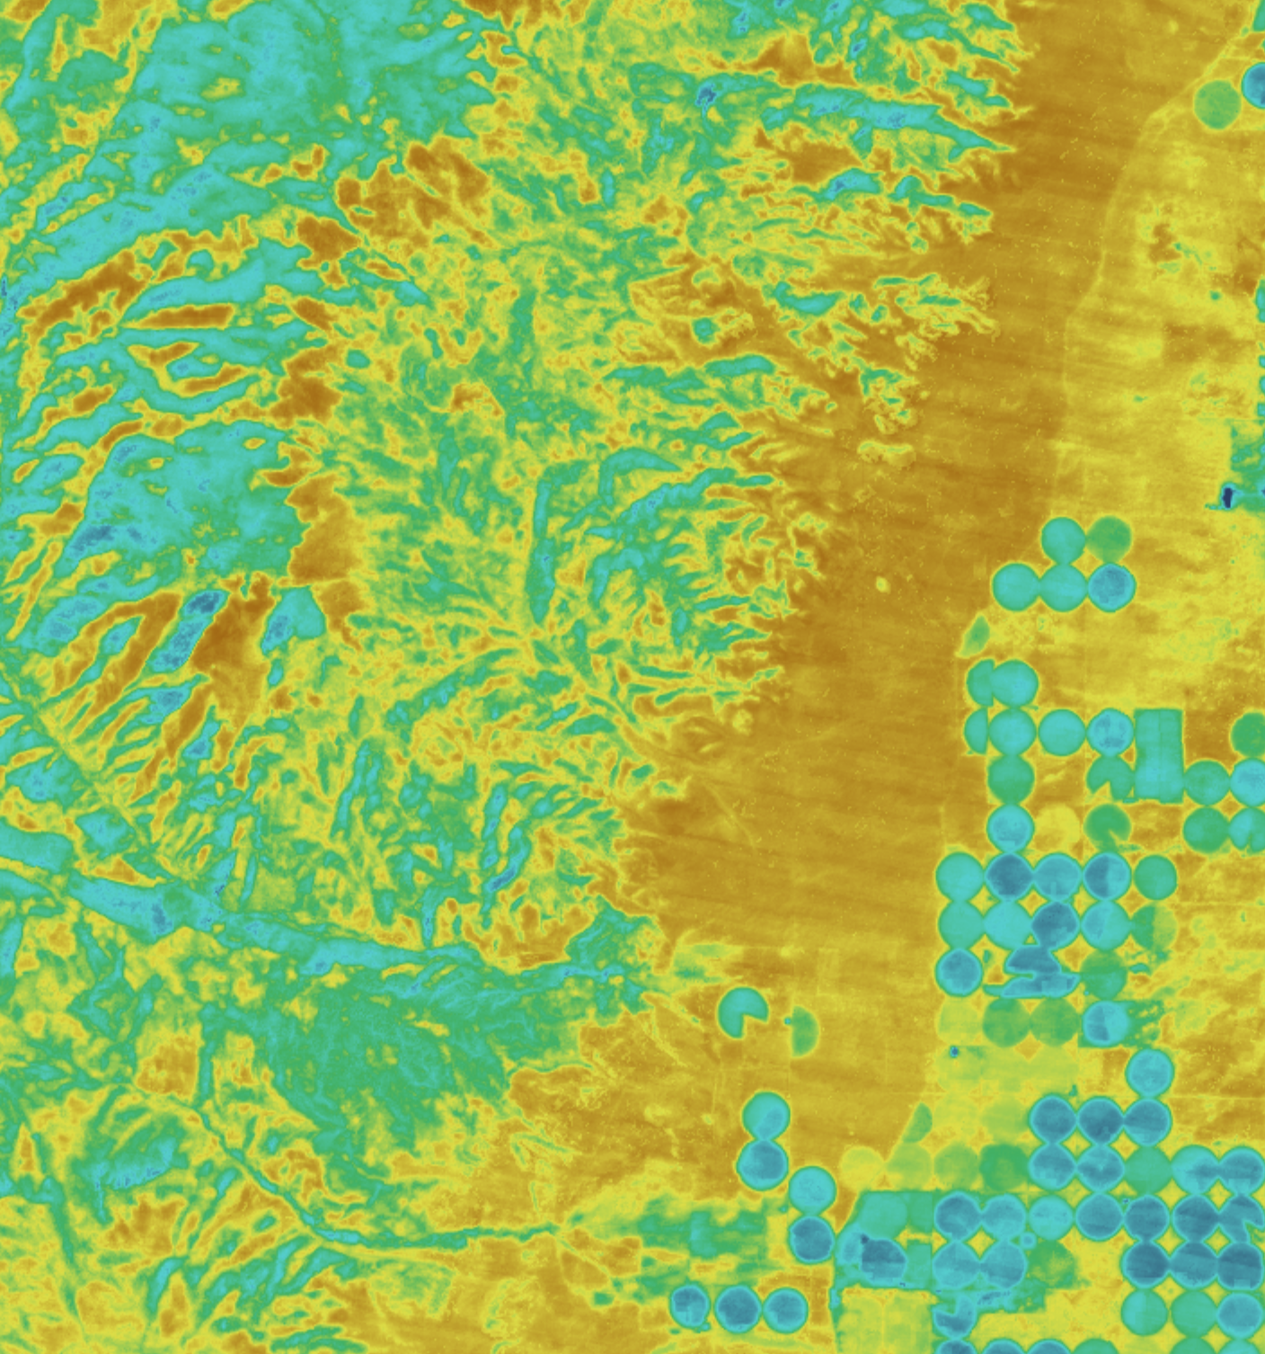
We can use remote sensing to estimate evapotranspiration at field scales across the Western USA

Slide 3
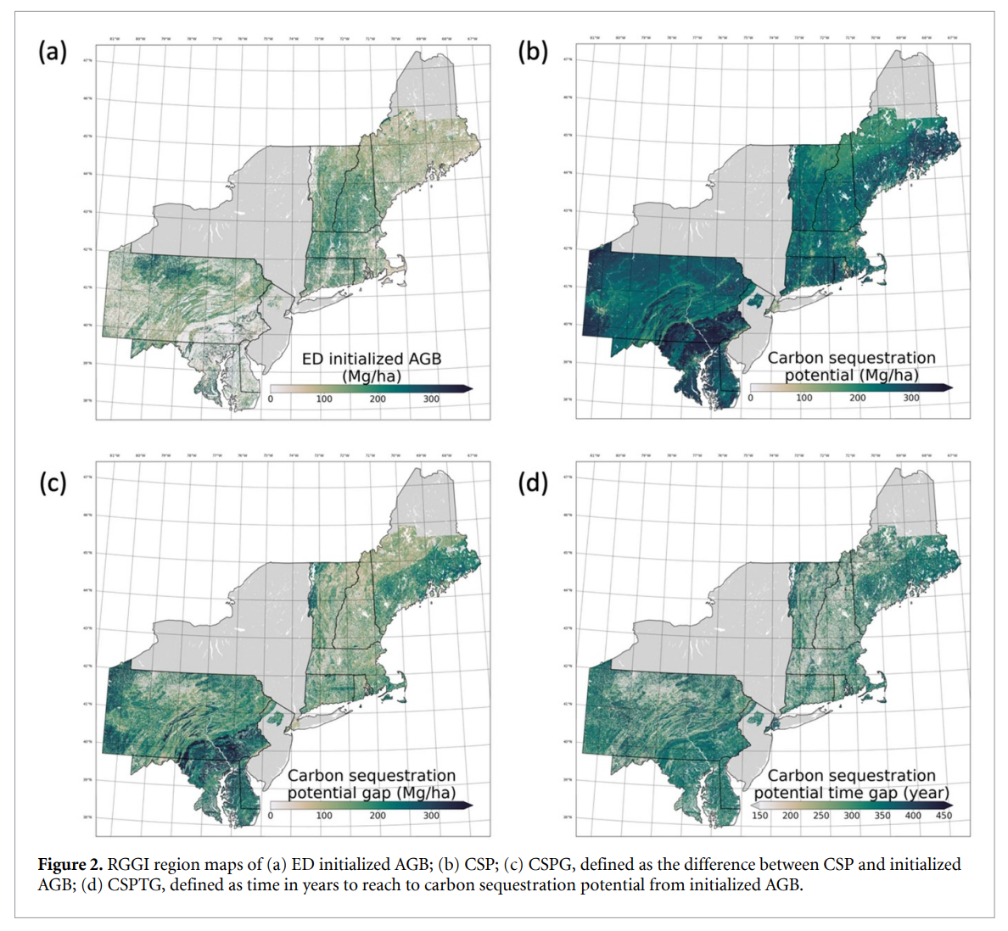
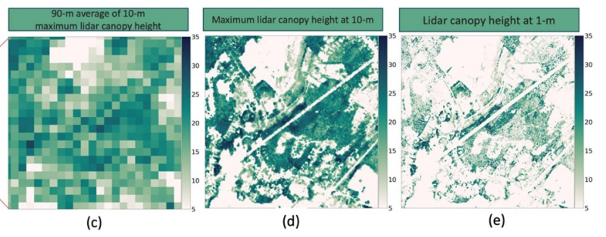
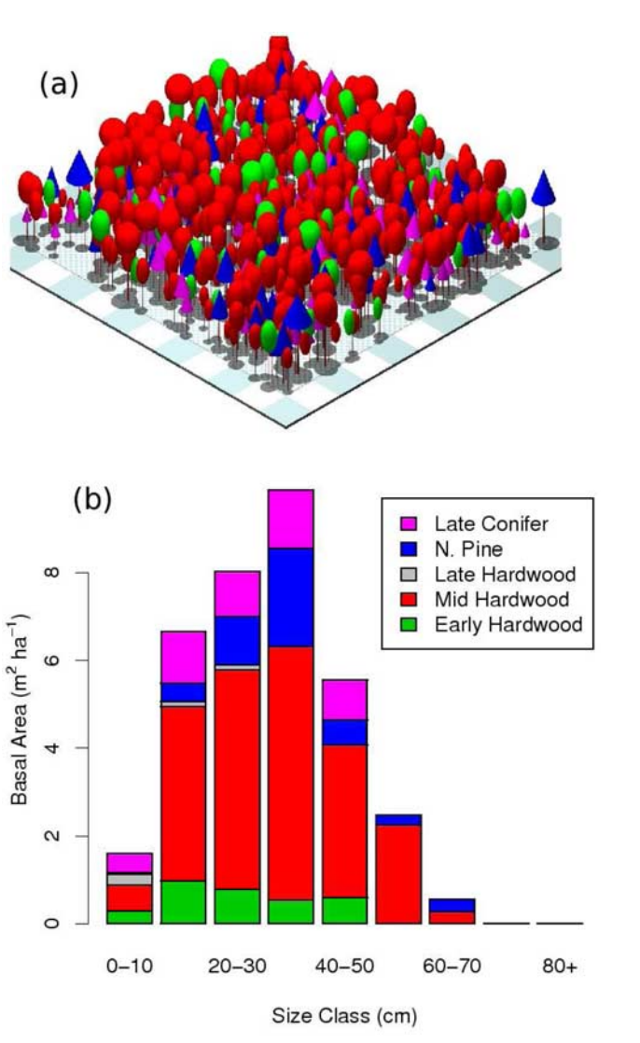
We can use remote sensing to estimate forest biomass and carbon sequestration potential across the Northeast
Figures: Ma et al. 2021, Moorcroft et al. 2001

Slide 4
These new tools could transform water and carbon policy.
Let's take a closer look.

Slide 5
Outline
Why are we using Remote Sensing to track carbon and water in new ways?
Why?
What?
How?
Why is this only happening now?
What is the scientific basis of these new systems, and where are the main uncertainties?
What present and future policies are they likely to enable?
How do we promote the good and avoid the peril of this widespread ecological surveillance?

Slide 6
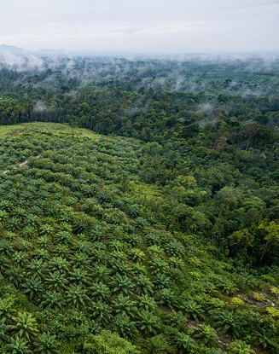
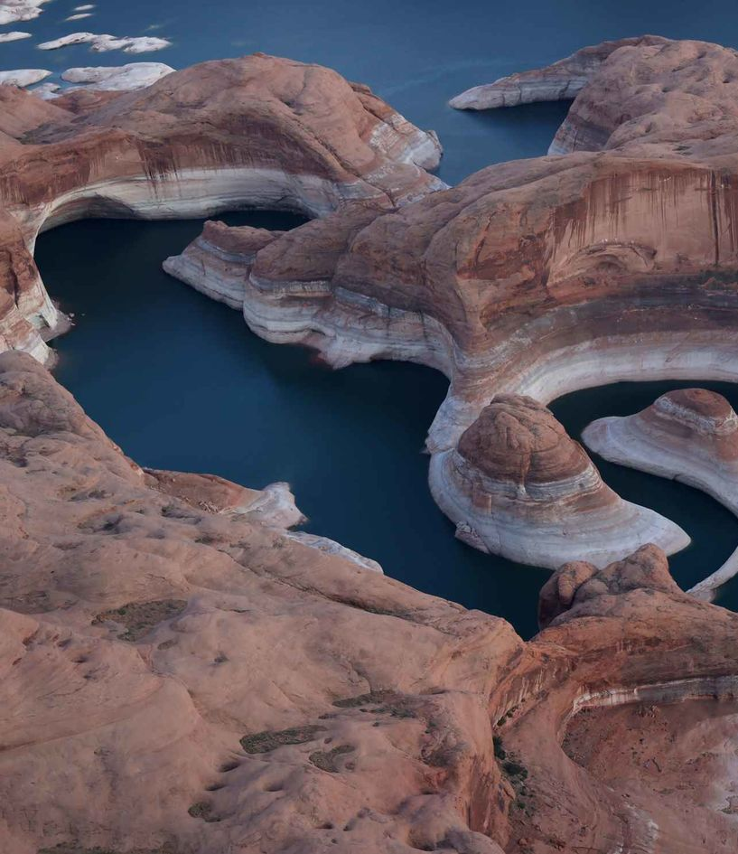
Why are we using Remote Sensing to track carbon and water in new ways?
Images: CIFOR / Justin Sullivan

Slide 7
Why is this happening now?
Ecological Knowledge
(models)
Weather and Remote Sensing
(data)
Fine-scale Water and Carbon Accounting
Scalable Cloud Infrastructure
(computing)

Slide 8
Outline
Why are we using Remote Sensing to track carbon and water in new ways?
Why?
What?
How?
Why is this only happening now?
What is the scientific basis of these new systems, and where are the main uncertainties?
What present and future policies are they likely to enable?
How do we promote the good and avoid the peril of widespread ecological surveillance?

Slide 9
What is the scientific basis of these systems?
What are they estimating, exactly?
What observations are they using to do it?
How do they get from observations to estimates?

Slide 10
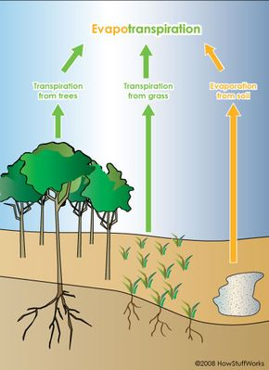
OpenET - Estimates of Actual Evapotranspiration (ET_{a})
ET_{a}: How much water leaves the earth surface per unit area per unit time.
Units: water depth / time, e.g. mm/month
Strongly correlated with Gross Primary Productivity
Different from Reference ET (ET₀)

Slide 11
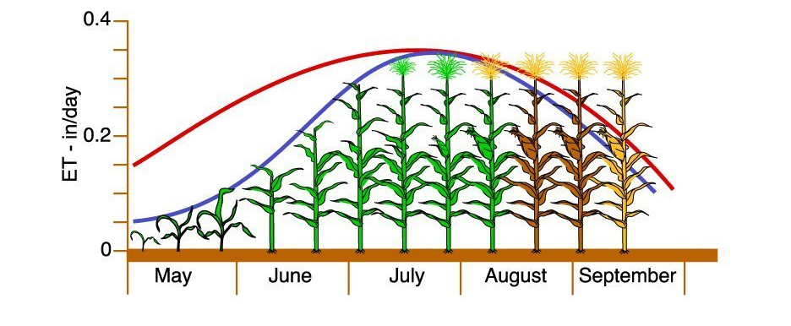
Reference ET (ET₀) vs Actual ET (ET_{a})
ET₀– ET of a well-watered reference (typically grass) given Solar Radiation, Wind, Air Temperature and Humidity.
Just weather data
Weather plus Vegetation
ET_{o}
ET_{a}
Figure: Kansas Mesonet

Slide 12
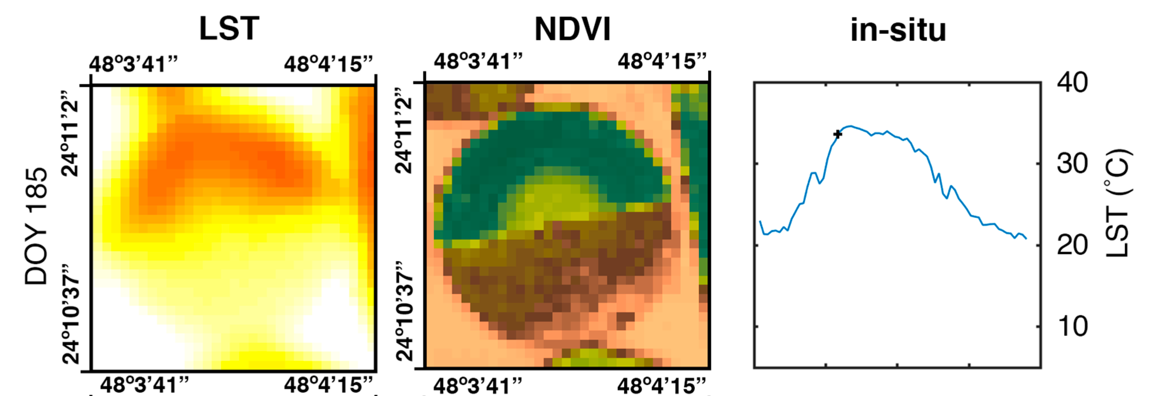
OpenET Source Data
Gridded Weather Data - > ET₀
Landsat / Sentinel Vegetation Indices to estimate ET_{a}/ET₀
Some models: Landsat Land Surface Temperature
Figure: Rosas et al. 2017

Slide 13
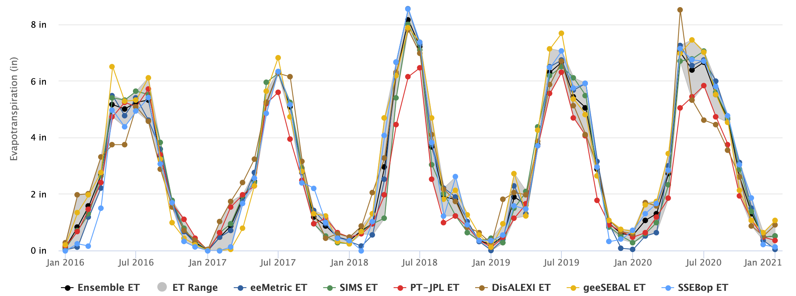
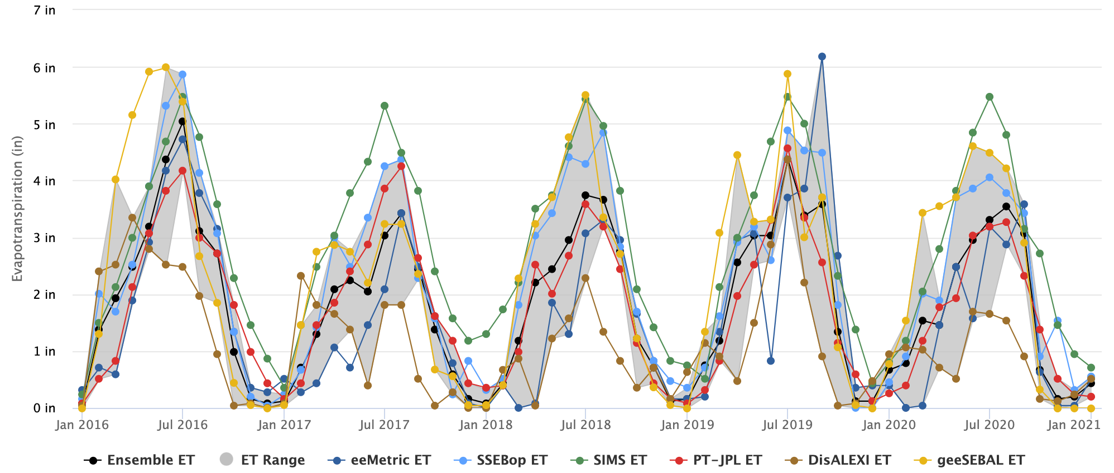
OpenET Model Ensemble – 6 Models
Alfalfa Field near Alamosa
Mixed Conifer Forest near Cochetopa Pass
Figures: OpenET

Slide 14
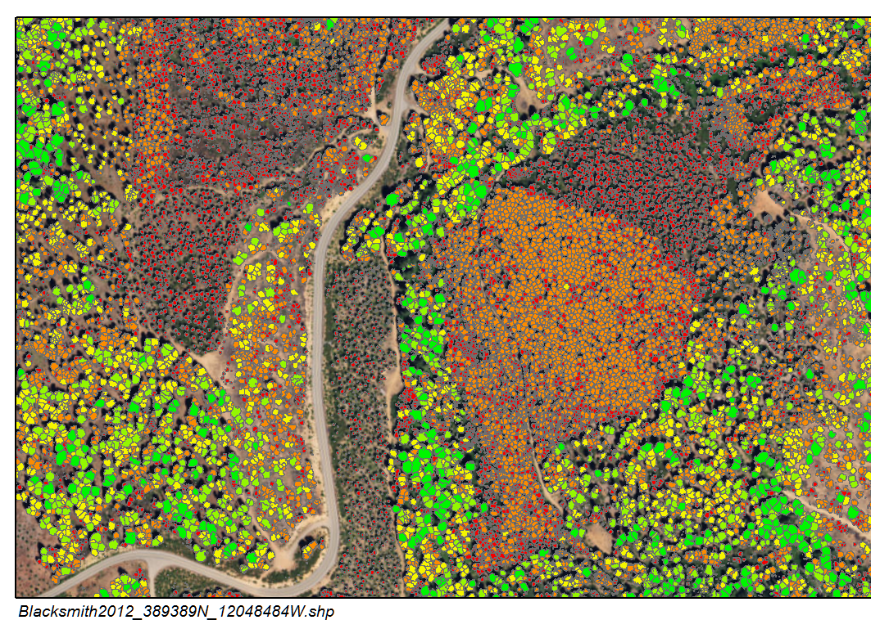
Ma et. Al. Biomass and Sequestration Potential
Figures: Ma et al. 2021, ORNL

Slide 15
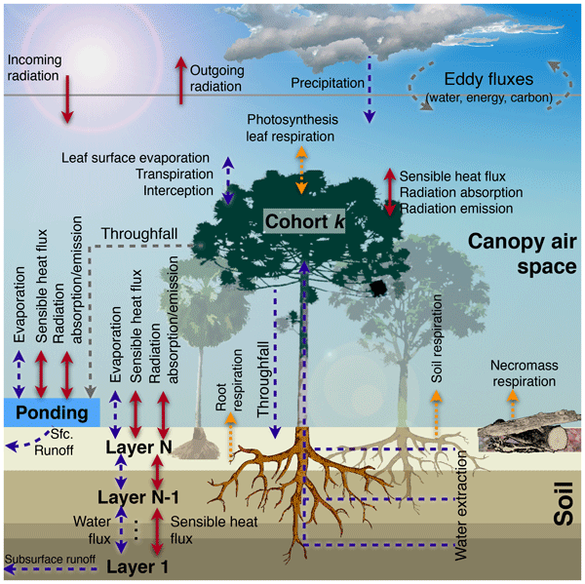
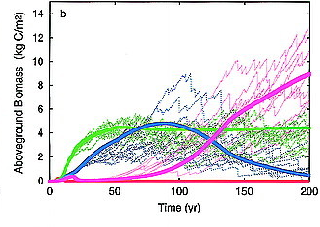
Ecosystem Demography Model (ED)
Figures: Longo et al. 2019, Moorcroft et al. 2001

Slide 16
Contrasting OpenET and Ma et Al.
 | OpenET | Ma et al.
Target | Actual Evapotranspiration (ET_{a}) | Aboveground Biomass and Sequestration Potential
Input Data | Gridded Weather, Landsat VIs, surface temperature | LiDAR canopy height, NAIP canopy cover
Models | Ensemble of 6 models | Ecosystem Demography Model
Code and Data Public? | Data – Yes, Code - Partially | Data – No, Code—Partially

Slide 17
Outline
Why are we using Remote Sensing to track carbon and water in new ways?
Why?
What?
How?
Why is this only happening now?
What is the scientific basis of these new systems, and where are the main uncertainties?
What present and future policies are they likely to enable?
How do we promote the good and avoid the peril of widespread ecological surveillance?

Slide 18
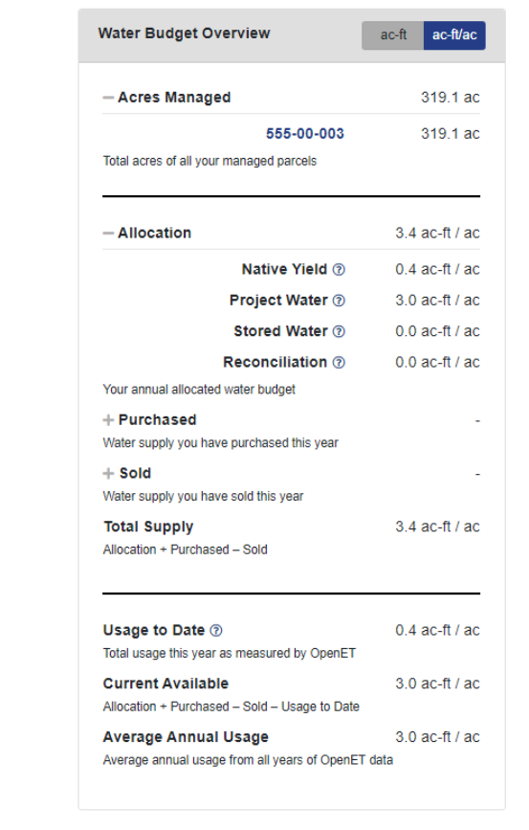
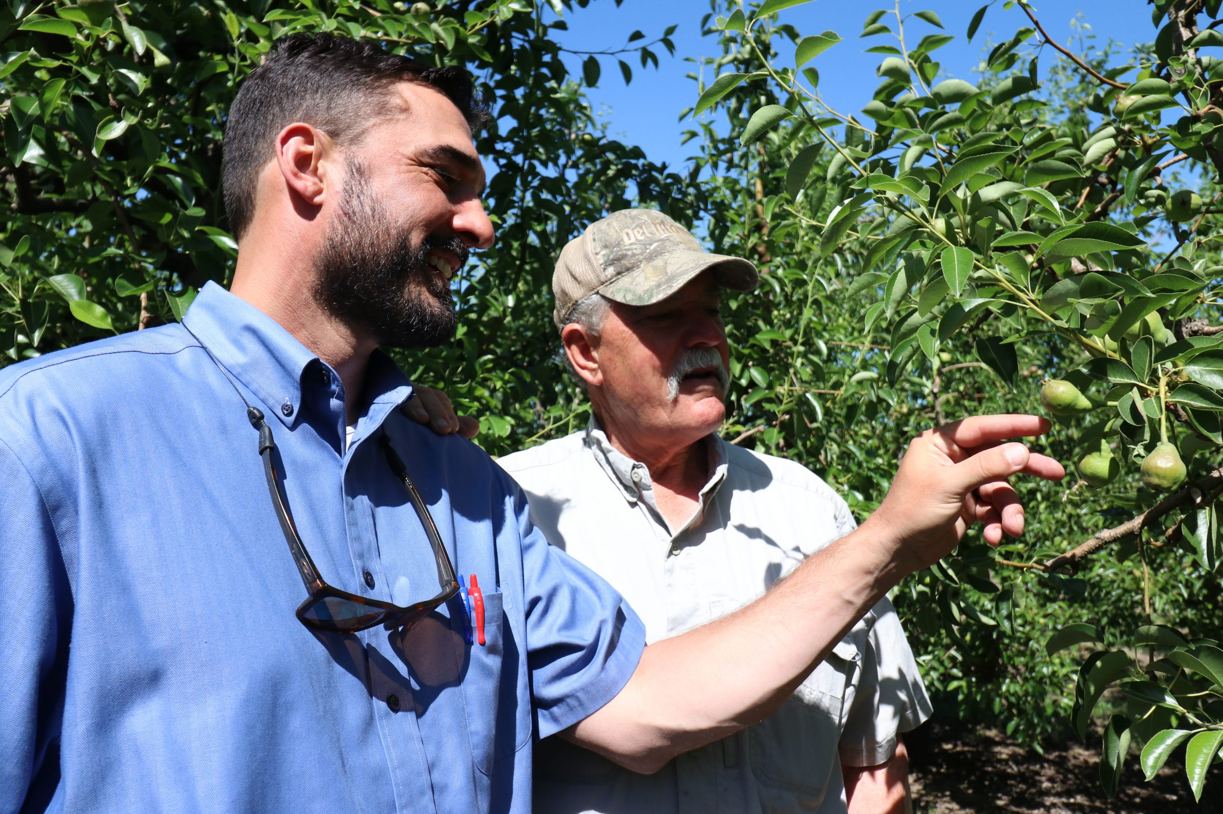
OpenET Policy Interfaces
California Example:
Environmental Defense Fund Water Accounting and Trading Platform
Image: Environmental Defense Fund

Slide 19
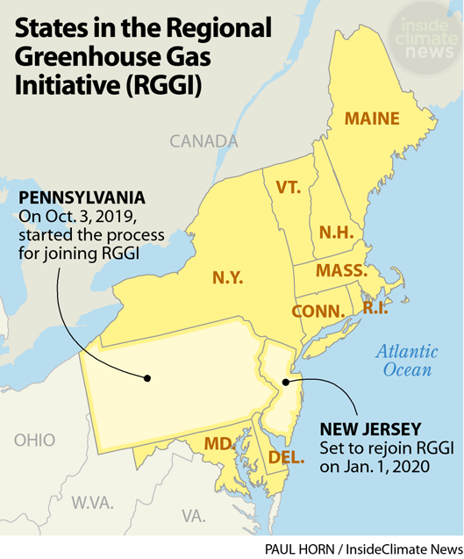
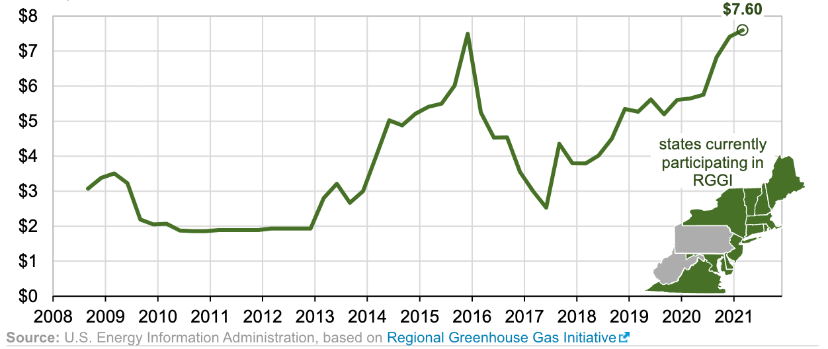
Ma et al. Policy Interfaces
Regional Greenhouse Gas Initiative (RGGI) future land carbon market?

Slide 20
Outline
Why are we using Remote Sensing to track carbon and water in new ways?
Why?
What?
How?
Why is this only happening now?
What is the scientific basis of these new systems, and where are the main uncertainties?
What present and future policies are they likely to enable?
How do we promote the good and avoid the peril of widespread ecological surveillance?

Slide 21

WMDs:
Opacity – systems that are not open to inspection or critique
Damage – systems that can have real negative consequences for people
Scale – systems that can be applied across large domains.

Slide 22


Slide 23
References:
Melton, Forrest S., Justin Huntington, Robyn Grimm, Jamie Herring, Maurice Hall, Dana Rollison, Tyler Erickson, et al. “OpenET: Filling a Critical Data Gap in Water Management for the Western United States.” JAWRA Journal of the American Water Resources Association n/a, no. n/a. Accessed January 23, 2022. https://doi.org/10.1111/1752-1688.12956.
Ma, L., G. Hurtt, H. Tang, R. Lamb, E. Campbell, R. Dubayah, M. Guy, et al. “High-Resolution Forest Carbon Modelling for Climate Mitigation Planning over the RGGI Region, USA.” Environmental Research Letters 16, no. 4 (April 2021): 045014. https://doi.org/10.1088/1748-9326/abe4f4.
Moorcroft, P. R., G. C. Hurtt, and S. W. Pacala. “A Method for Scaling Vegetation Dynamics: The Ecosystem Demography Model (Ed).” Ecological Monographs 71, no. 4 (2001): 557–86. https://doi.org/10.1890/0012-9615(2001)071[0557:AMFSVD]2.0.CO;2.
Longo, Marcos, Ryan G. Knox, David M. Medvigy, Naomi M. Levine, Michael C. Dietze, Yeonjoo Kim, Abigail L. S. Swann, et al. “The Biophysics, Ecology, and Biogeochemistry of Functionally Diverse, Vertically and Horizontally Heterogeneous Ecosystems: The Ecosystem Demography Model, Version 2.2 – Part 1: Model Description.” Geoscientific Model Development 12, no. 10 (October 14, 2019): 4309–46. https://doi.org/10.5194/gmd-12-4309-2019.
Rosas, Jorge, Rasmus Houborg, and Matthew F. McCabe. “Sensitivity of Landsat 8 Surface Temperature Estimates to Atmospheric Profile Data: A Study Using MODTRAN in Dryland Irrigated Systems.” Remote Sensing 9, no. 10 (October 2017): 988. https://doi.org/10.3390/rs9100988.
O’neil, Cathy. Weapons of Math Destruction: How Big Data Increases Inequality and Threatens Democracy. Crown, 2016.

